Slide 1

& Digital Collections

Slide 2
A simple, standardized, legally robust way to grant © permissions to cultural works and data

Slide 3


Slide 4
CC Licenses
Enable © holders to grant copy and reuse permissions to the public
6 licenses:
Some grant commercial uses
Some grant derivative uses
All require attribution

Slide 5




4 Elements
Attribution
ShareAlike
NonCommercial
NoDerivatives

Slide 6
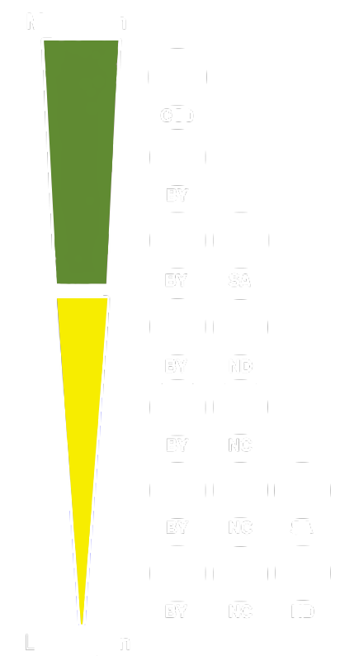
Public Domain Dedication
Licenses

Slide 7

CC Zero =
I want to waive all of
MY rights to a work.
(legally operable)

Slide 8
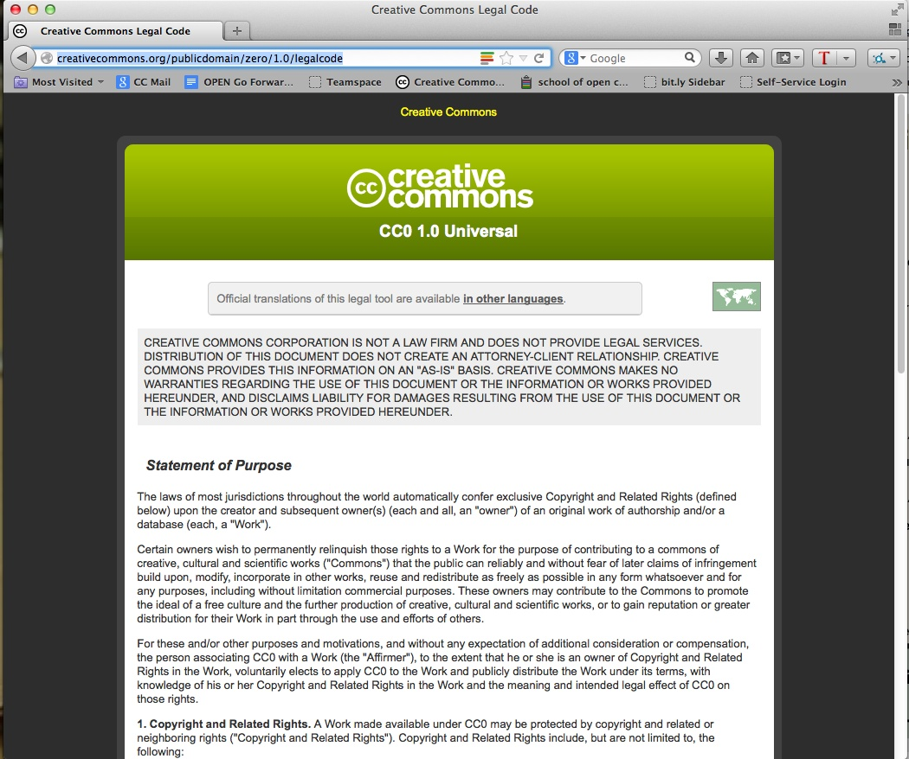

Slide 9

PD Mark =
For works already in the public domain.
(legally operable)

Slide 10
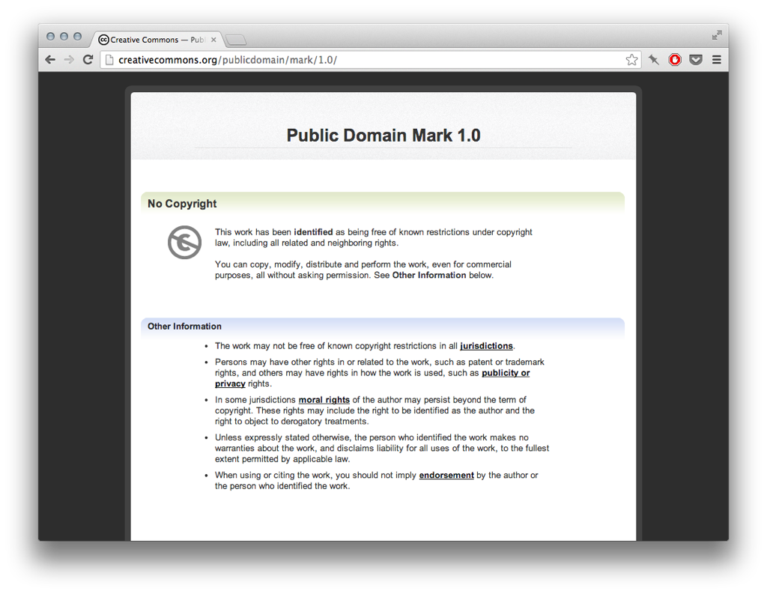

Slide 11
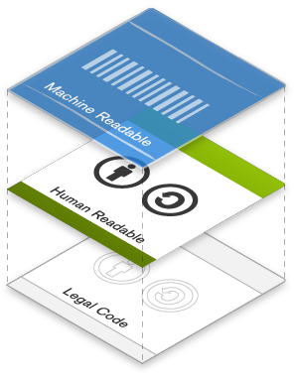

Slide 12
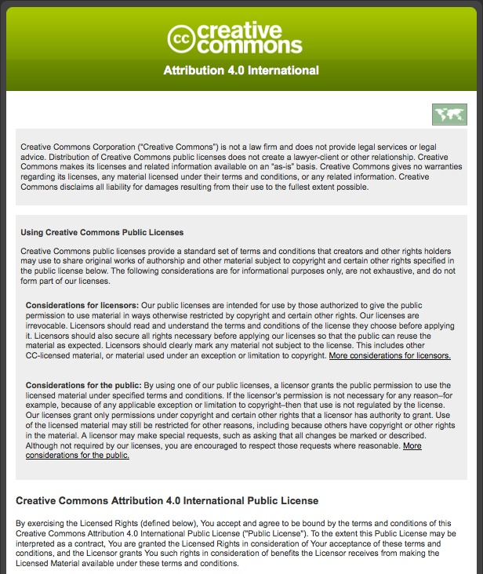
Lawyer
Readable
Legal Code

Slide 13
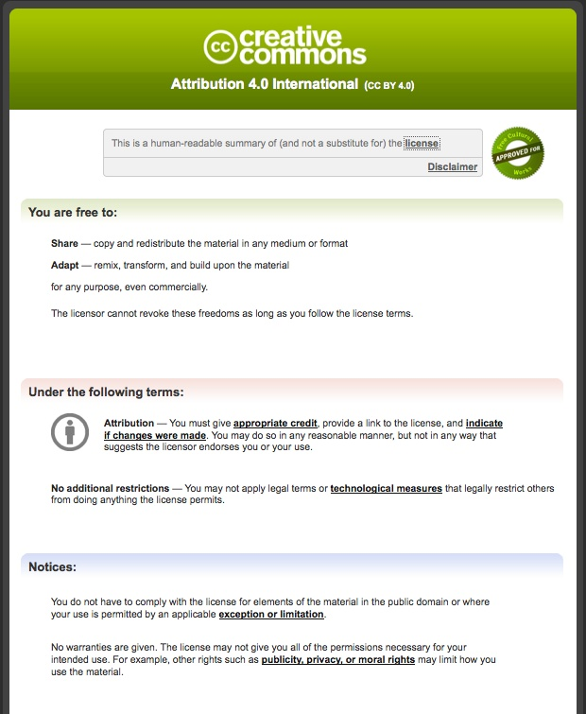
Human
Readable Deed

Slide 14
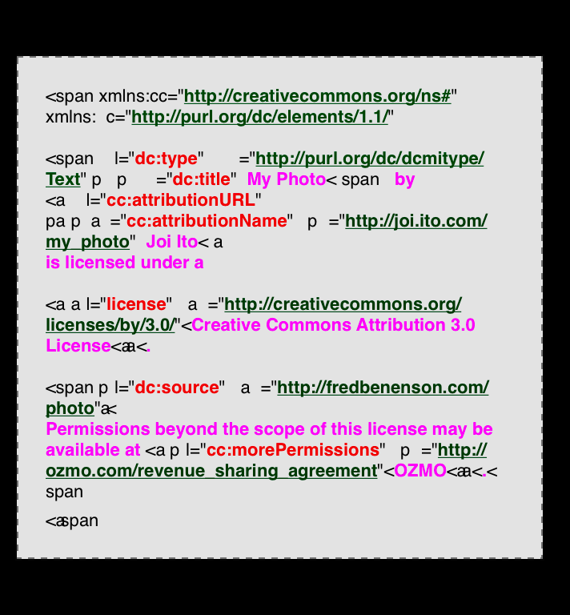
Machine
Readable Metadata

Slide 15
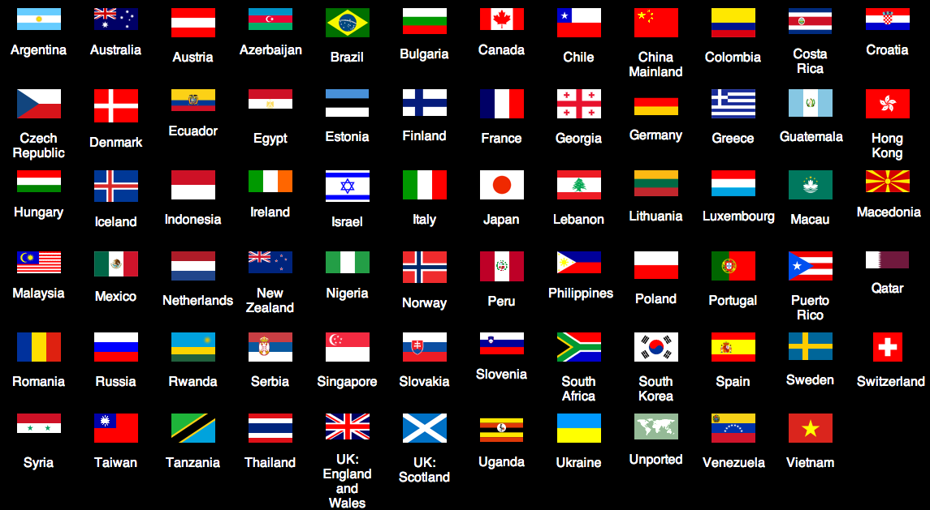


Slide 16
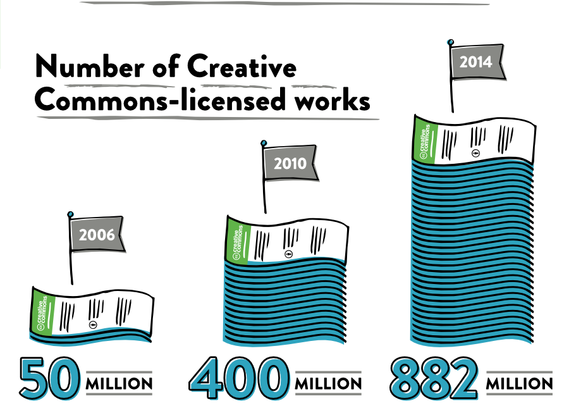

Slide 17

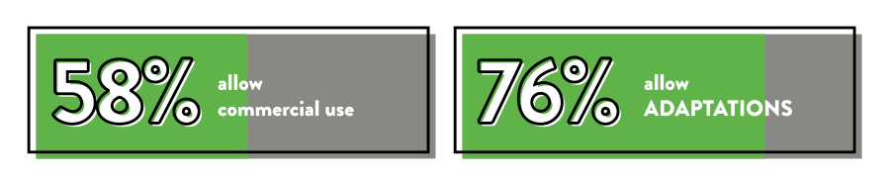

Slide 18

Digital collections

Slide 19
Rijksmuseum
150,000 images of its public domain collection released via CC0
Initial hesitation, but marketing dept argued that “the digital reproduction of an item would pique public interest in it, leading them to buy tickets to the museum to see the real deal”

Slide 20
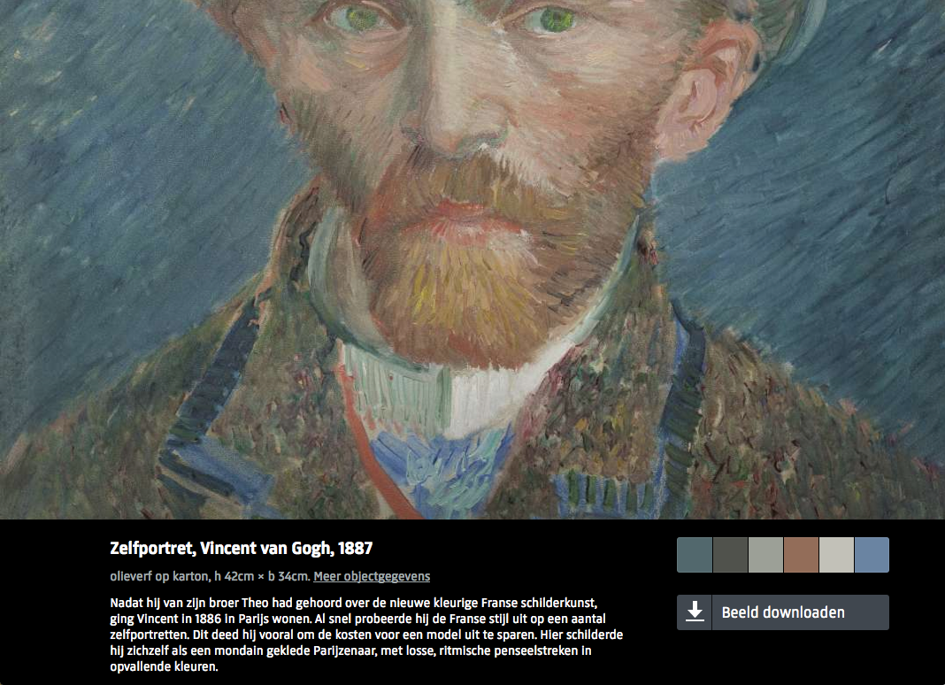
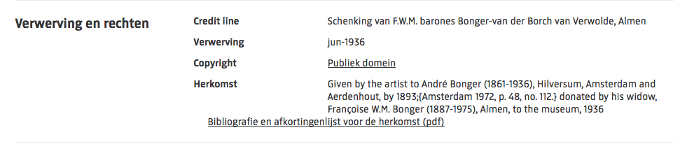



Slide 21
Brooklyn Museum
100k+ online image collection
CC BY for images and text owned by museum; PD for PD works
Most restrictive → most open
2004: CC BY-NC-ND
2010: CC BY-NC
Today: CC BY & PD statement

Slide 22
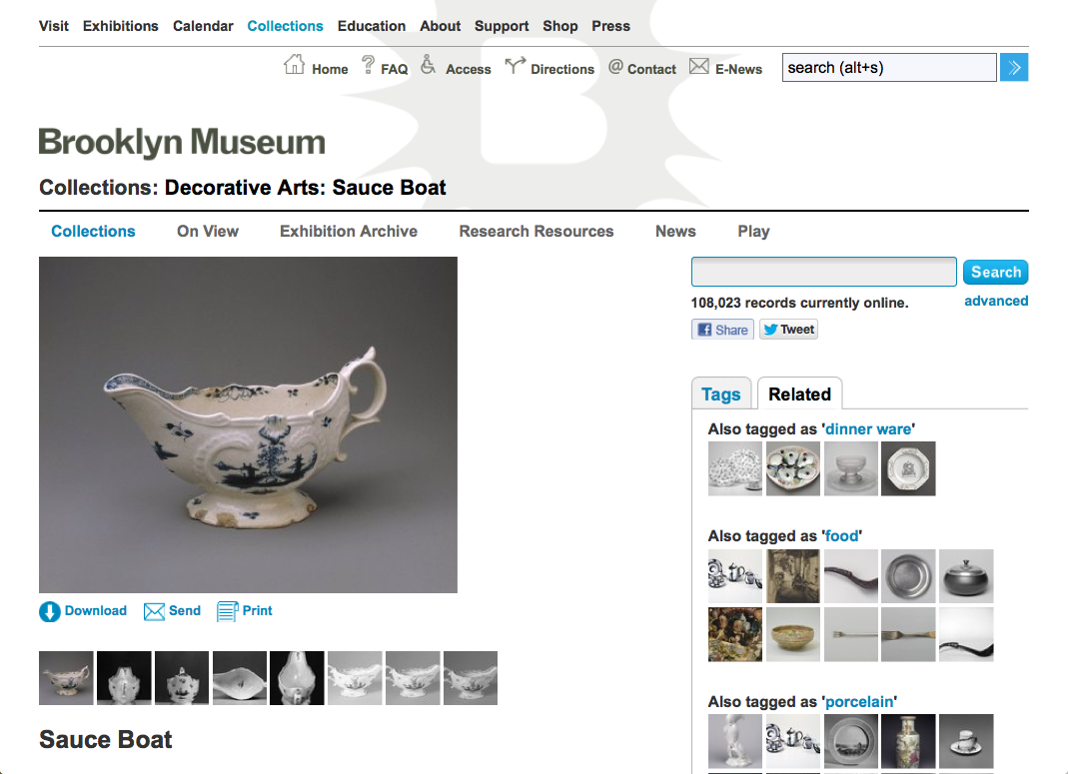

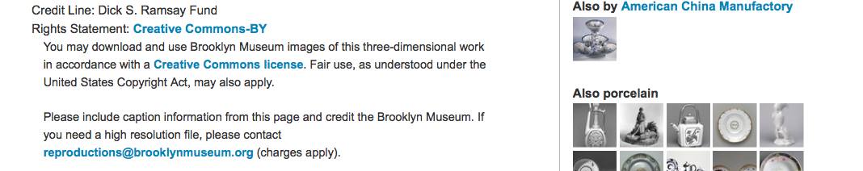

Slide 23
New York Public Library
20,000 cartographic works released as high resolution downloads via CC0
CC0 for digital reproductions b/c maps are in the public domain
“We believe our collections inspire all kinds of creativity, innovation and discovery."

Slide 24
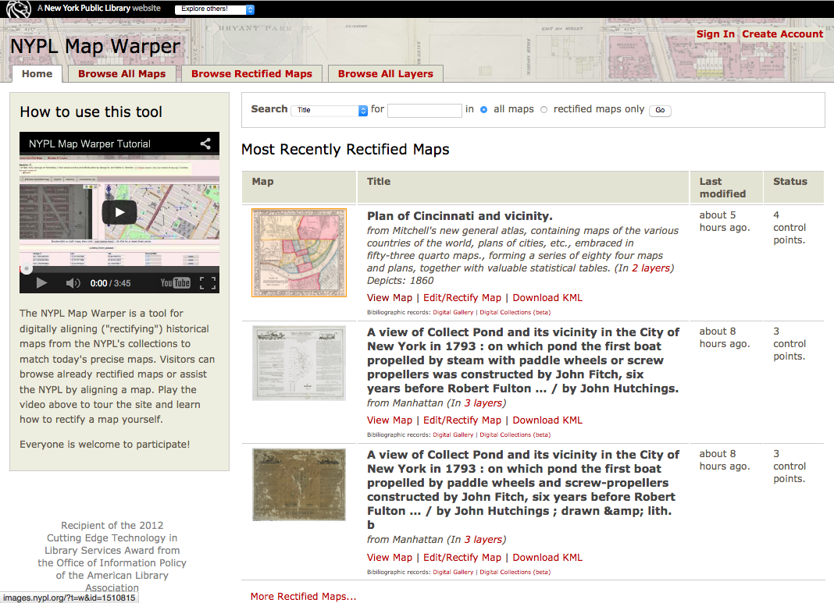

Slide 25
Powerhouse Museum
An ‘Electronic Swatchbook’
All in the public domain (in Australia)
"Through this site we are providing access to this rich resource for future generations of designers"

Slide 26
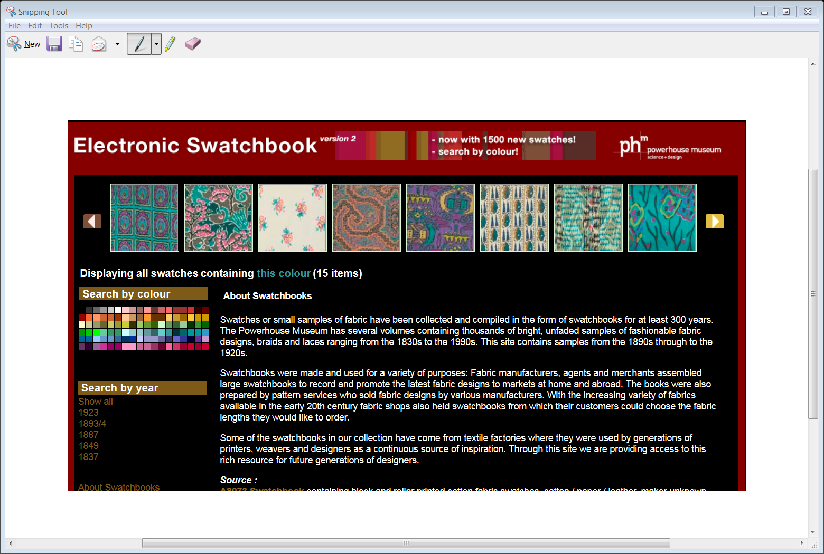

Slide 27
Engaging
Users +
Community
Sharing
Digital
Collections
Sharing
Collection
Records

Slide 28
CC licenses are robust, built on © law
Clarity and specificity regarding use
Data embedded w/assets; enables browse/search filters
Minimizes overhead for individual transactions
Clear way to share PD collections

Slide 29
Promotional & educational tool
Increases reach + impact of museum
Good will w/public, creative industries
Enable unexpected, creative & delightful results
Lead to refocusing of resources, new funding + revenue models

Slide 30
Resources
Warwick Cathro. 2007 .“Federated discovery opportunities for Australia’s collecting institutions” https://www.nla.gov.au/openpublish/index.php/nlasp/article/viewFile/1035/1303
Mansfield, T., Winter, C., Griffith, C., Dockerty, A., Brown, T. 2014. “An Innovation Study: Challenges and Opportunities for Australia’s Galleries, Libraries, Archives and Museums”. http://museumsaustralia.org.au/userfiles/file/GLAM_Innovation_Study_September2014-Report_Final_accessible.pdf
The Open Data Handbook http://opendatahandbook.org/en/
Australian Government Open Access Framework (AusGOAL) http://www.ausgoal.gov.au

Slide 31


This work, “Creative Commons & Digital Collections ", is a derivative of "Creative Commons and cultural heritage" by Jane Park used under CC BY. " Creative Commons & Digital Collections " is licensed under CC BY by Nerida Quatermass.
Except where otherwise noted: CC BY creativecommons.org/licenses/by/4.0
Creative Commons and the double C in a circle are registered trademarks of Creative Commons in the United States and other countries. Third party marks and brands are the property of their respective holders.

